Slide 1
Naveen raj Rekha Sql assignment PG id: 2002019

Slide 2
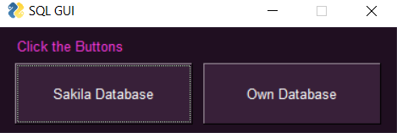
Main Dialogue Box

Slide 3
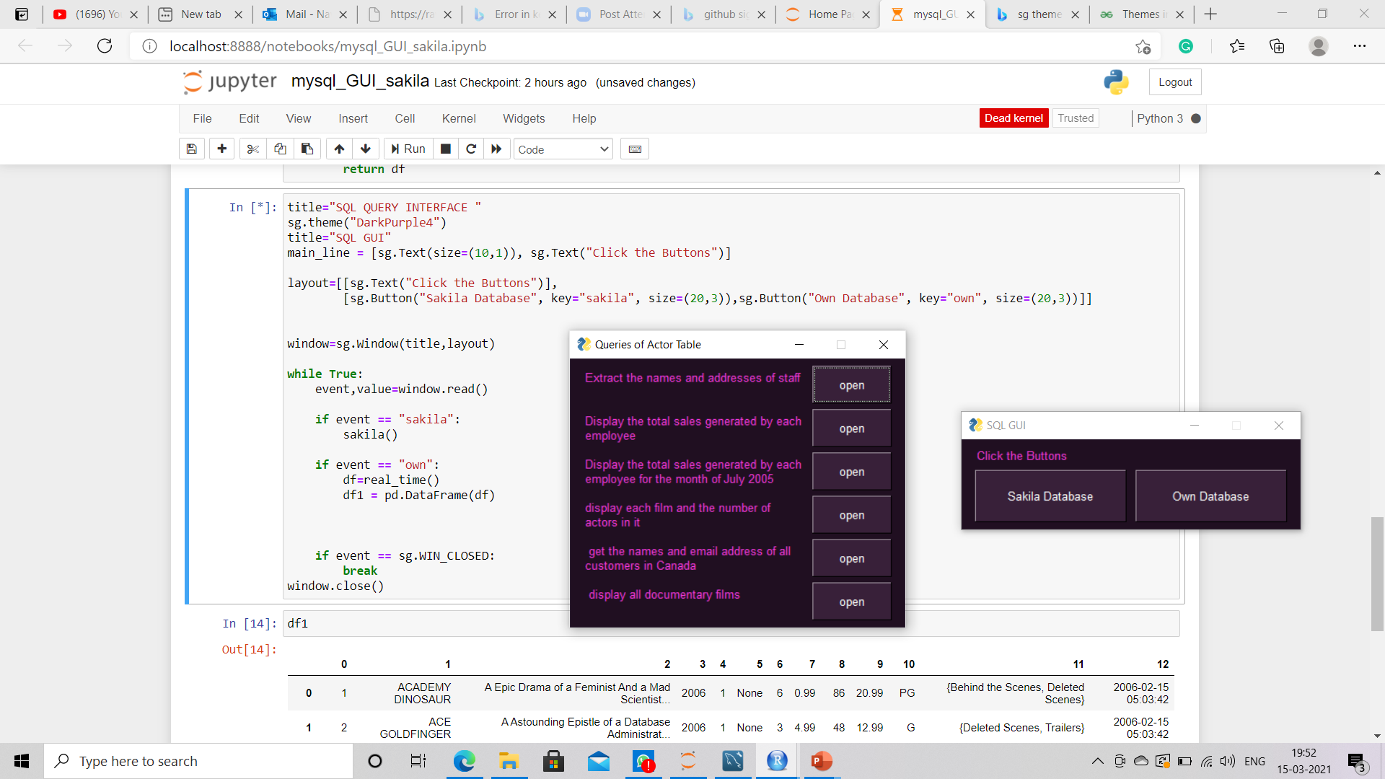
Query Options for Sakila Database

Slide 4
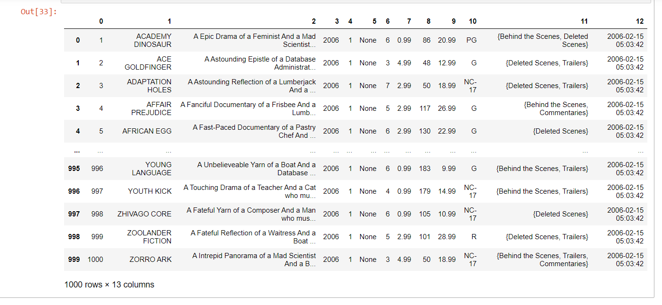
Sample Output of the 5th Query

Slide 5
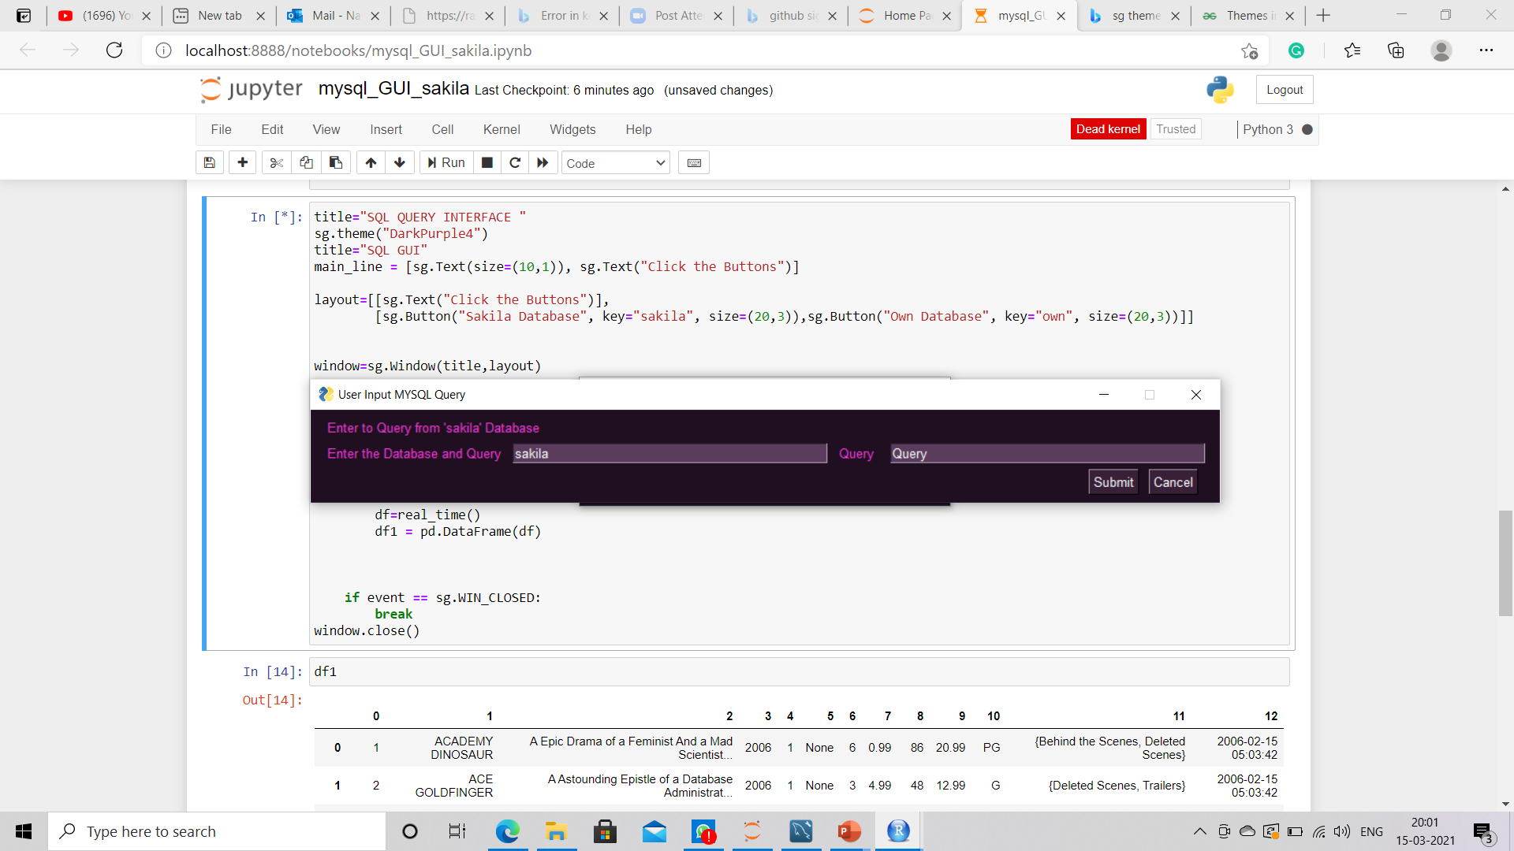
User-based Dialogue Box

Slide 6
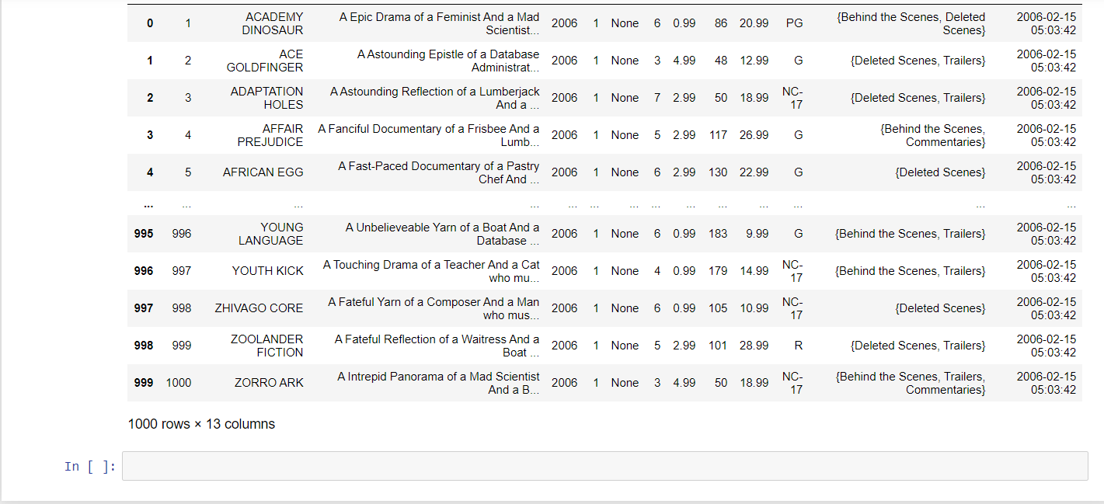
Sample Output of the User-based Query

Slide 7
Thankyou

